Slide 1
Herbacious Flowers
East of the Cascade Crest

Slide 2
Practice Identifying these species.
Identify the family
Use Washington Wildflower Search (Cle Elm or Ellensburg Area, 3500-4500 ft Elevation, and mid-June time period)
Use Burke Museum App (Washington Wildflower) or UW Burke Herbarium image collection.
Use Books of the flowers of East of the Cascade Crest
Many plants have multiple common names in use
In Powerpoint, change to Outline View and the answers will be in the outline window.
Openoffice.org should give a free way of opening powerpoints.

Slide 3
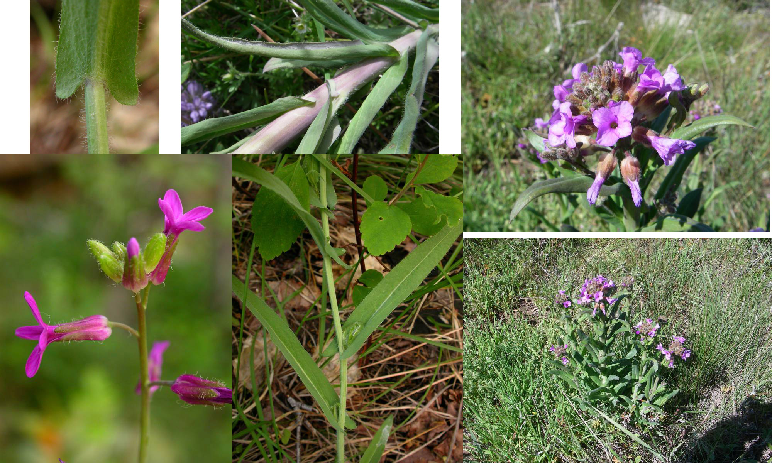
Sicklepod rockcress – Mustard Family

Slide 4
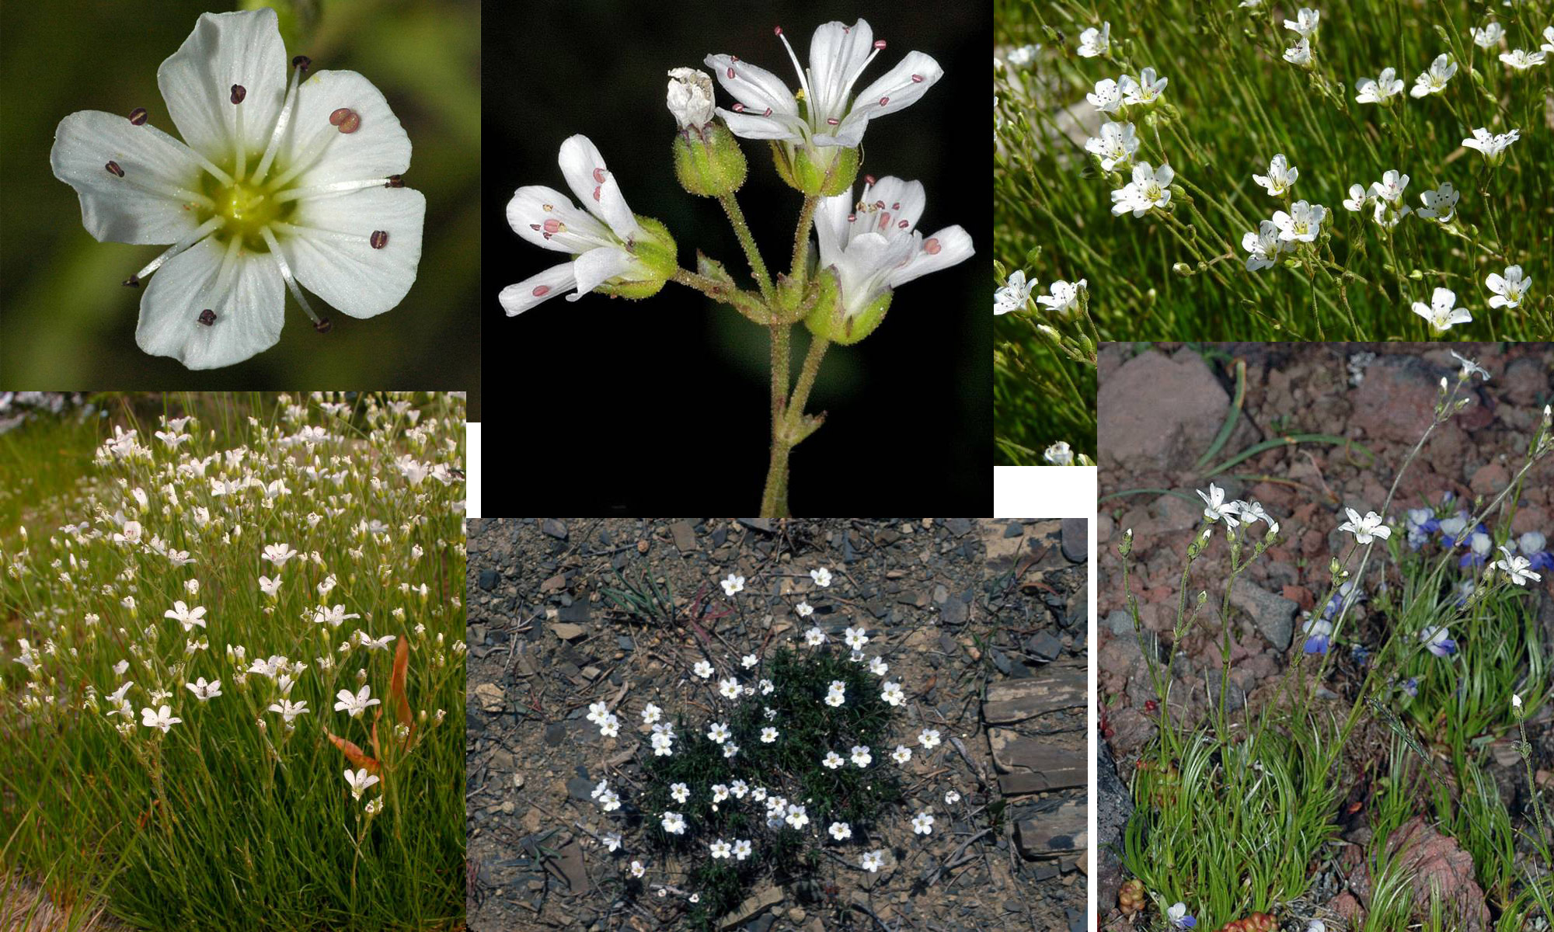
Thread-leaved Sandwort – Pink Family

Slide 5
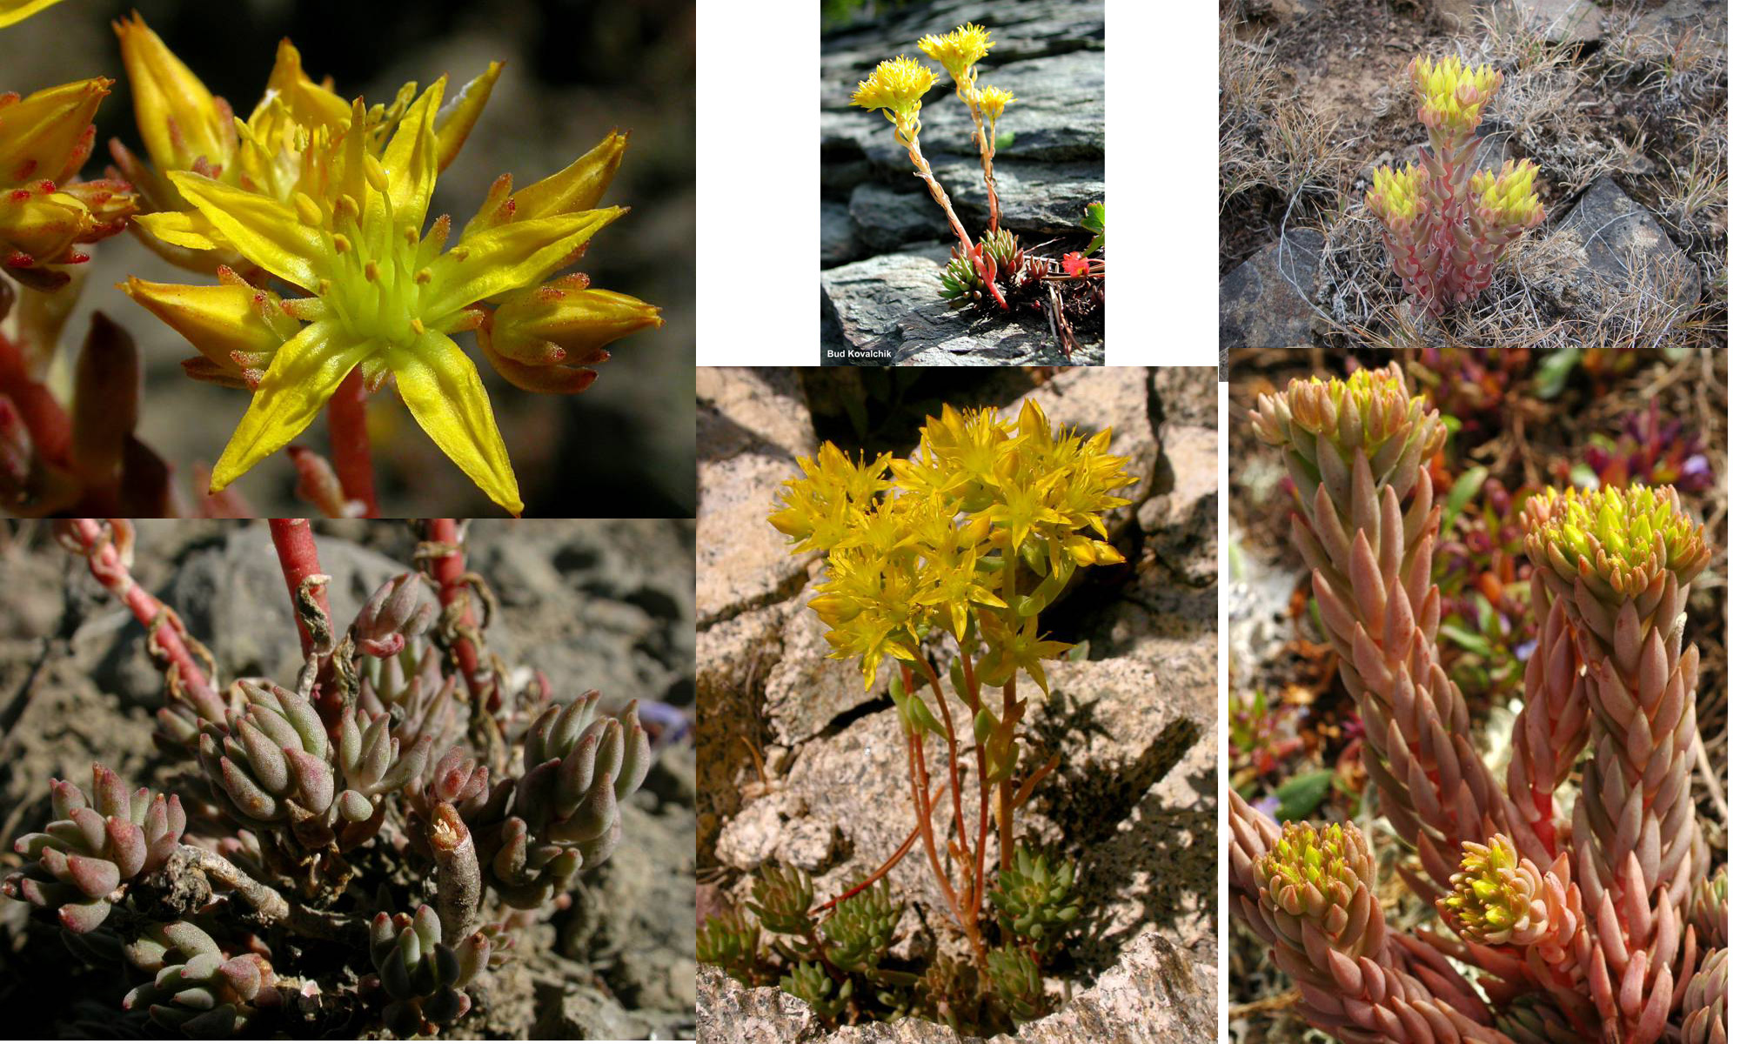
Lance-leaved Stonecrop – Stonecrop Family

Slide 6
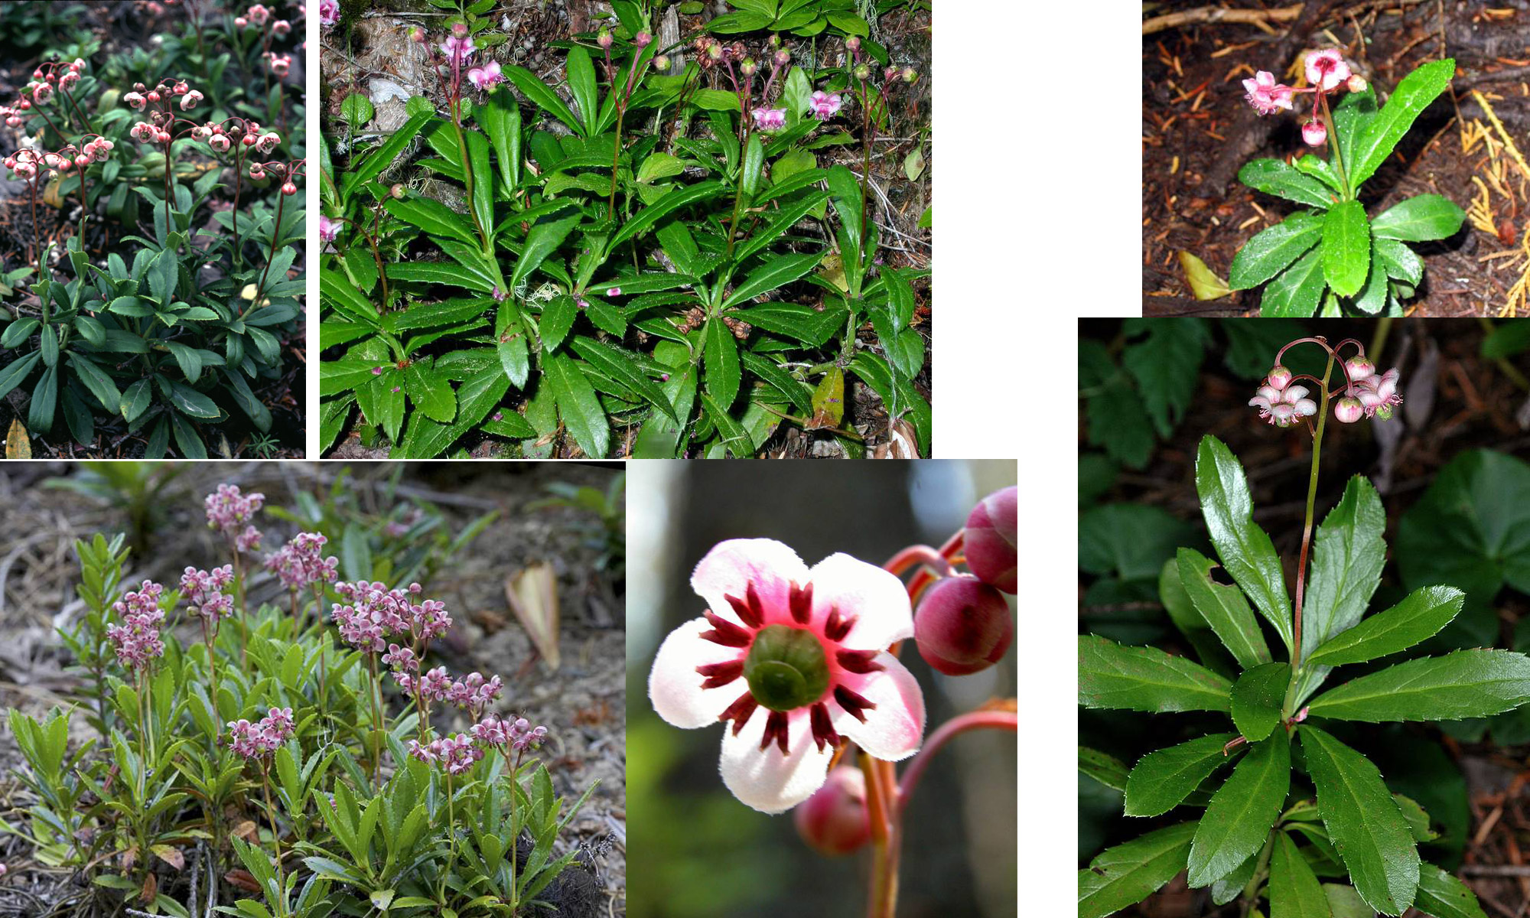
Pipsissewa – Heath Family

Slide 7
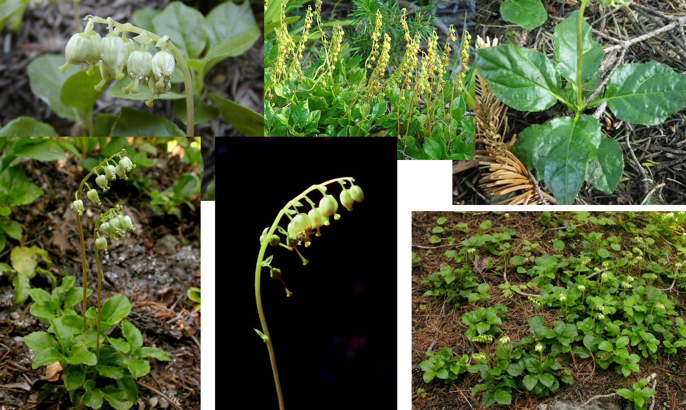
One-sided Wintergreen – Heath Family

Slide 8
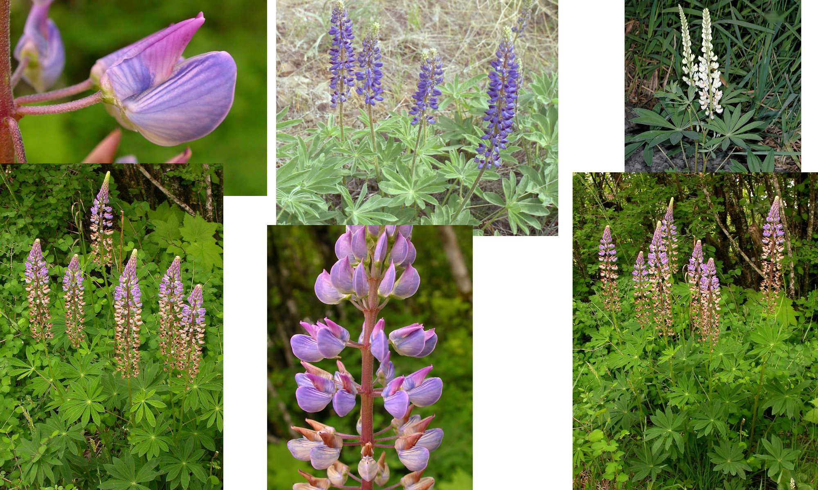
Big-leafed Lupine – Pea Family

Slide 9
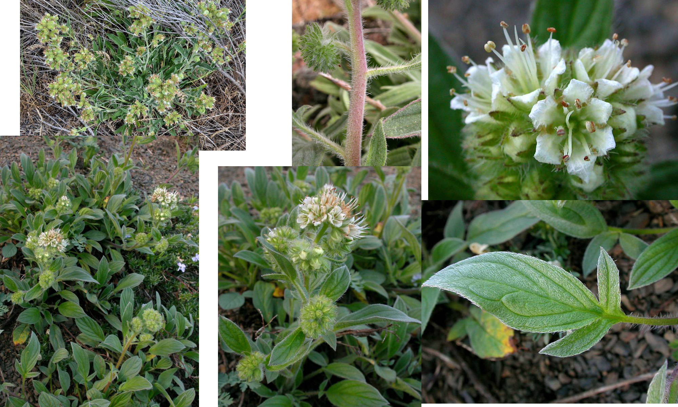
White-leaf Phacelia – Waterleaf Family

Slide 10
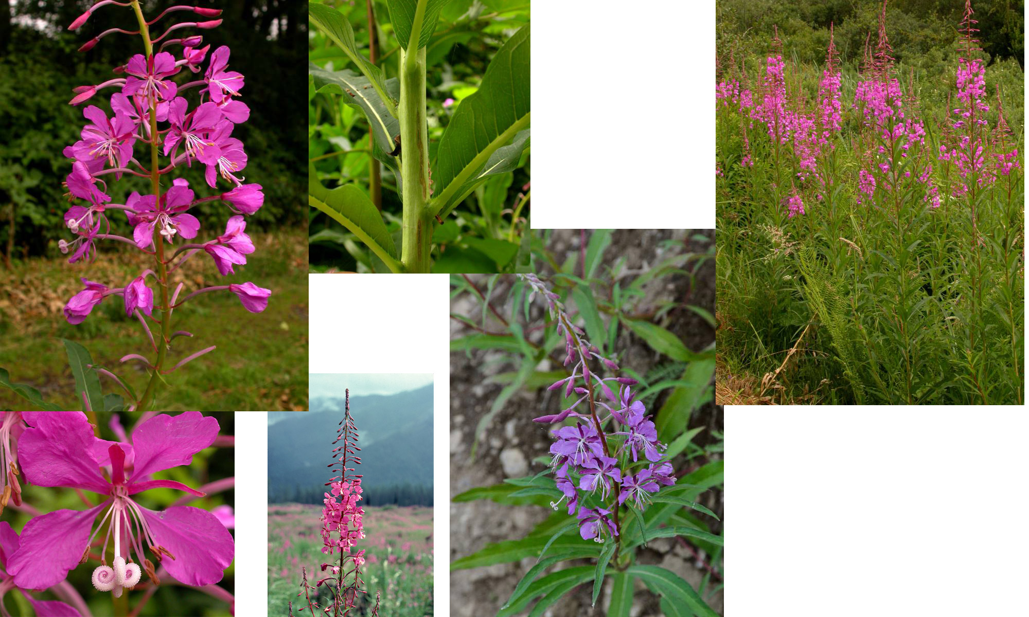
Fireweed – Evening-Primrose

Slide 11
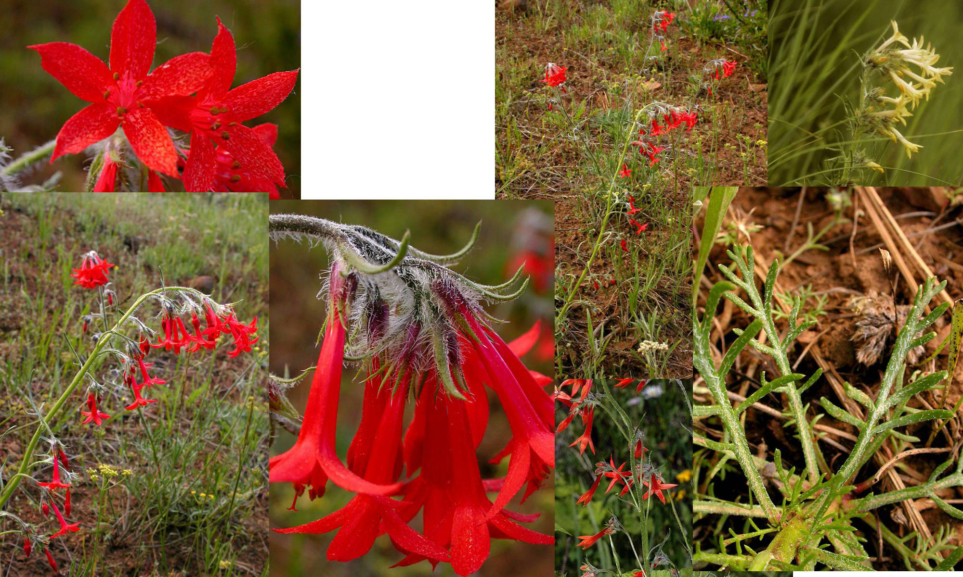
Skyrocket – Phlox Family

Slide 12
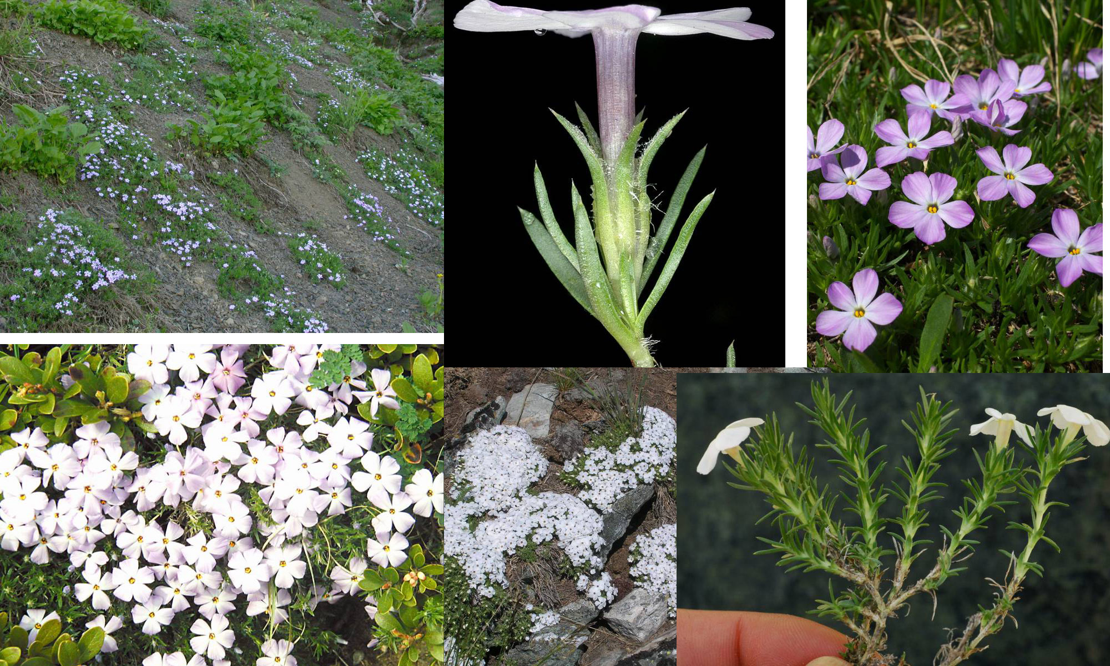
Spreading Phlox – Phlox Family

Slide 13
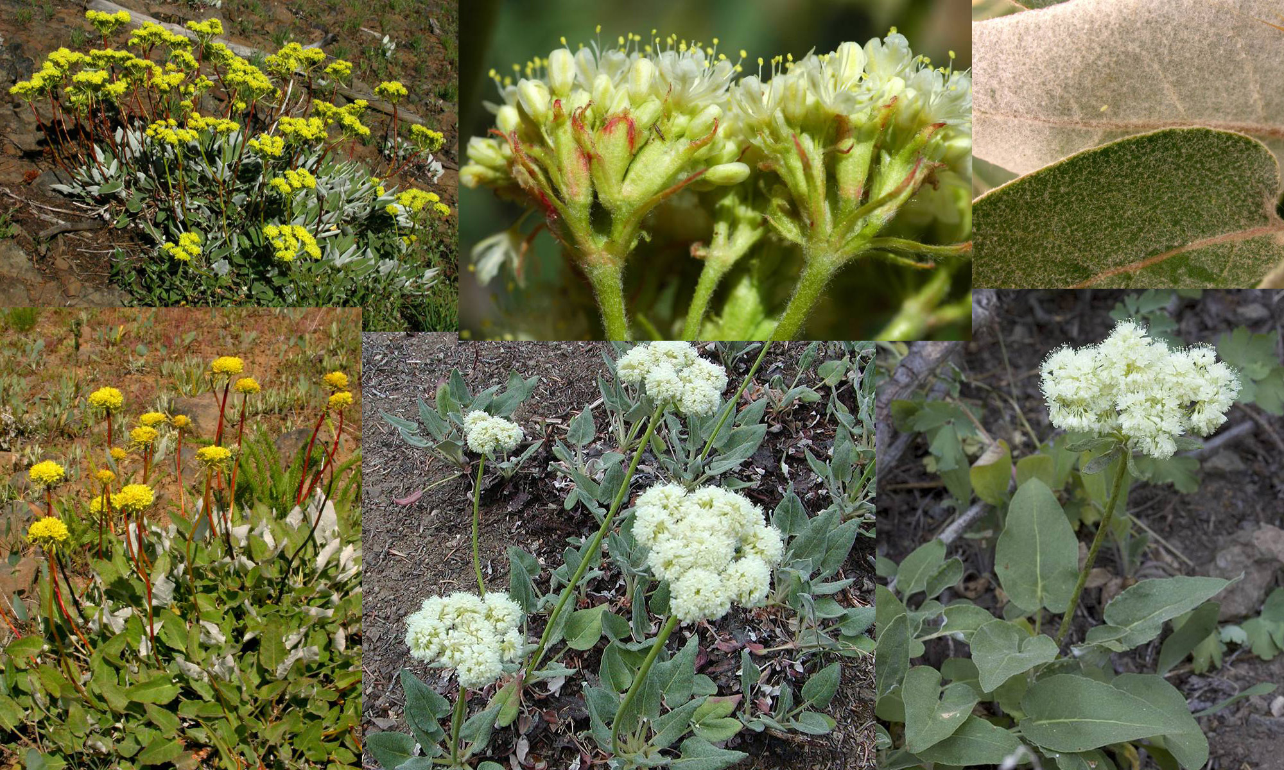
Northern Buckwheat – Buckwheat Family

Slide 14
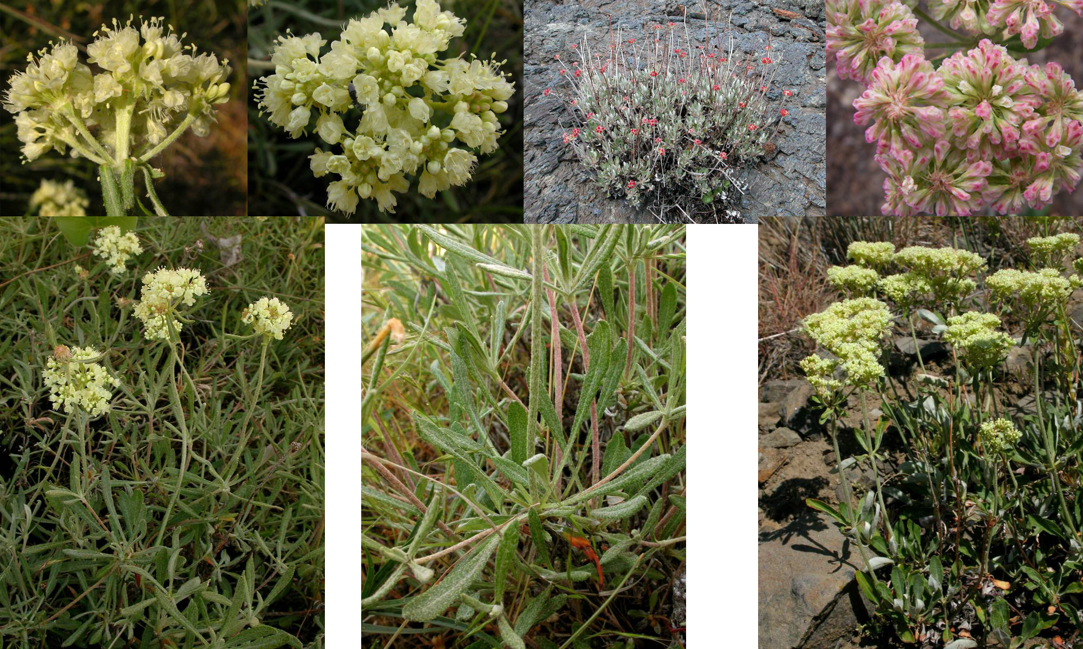
Parsnip-flowered Buckwheat – Buckwheat Family

Slide 15
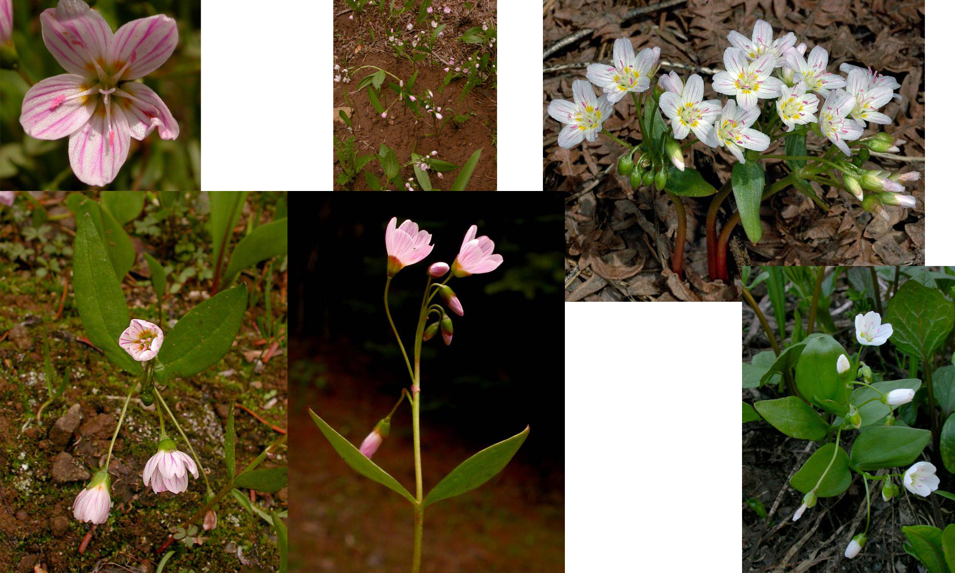
Western Springbeauty – Purslane Family

Slide 16
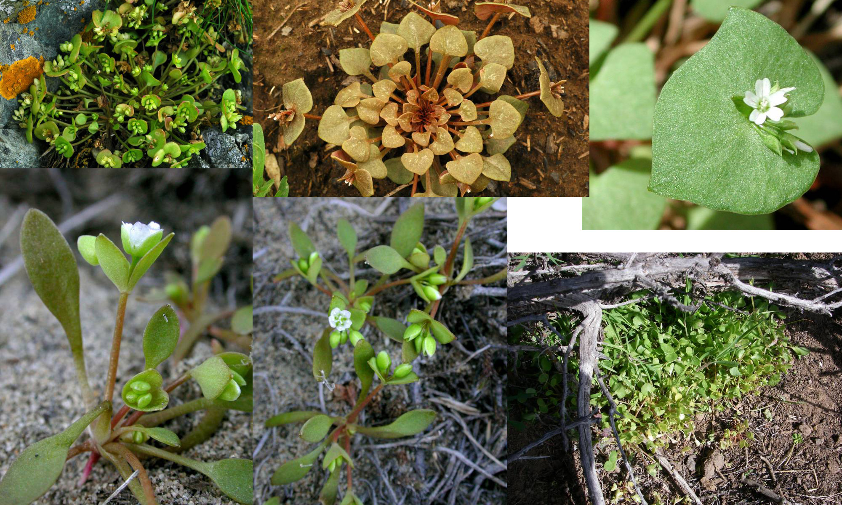
Red Miner’s Lettuce – Purslane Family

Slide 17
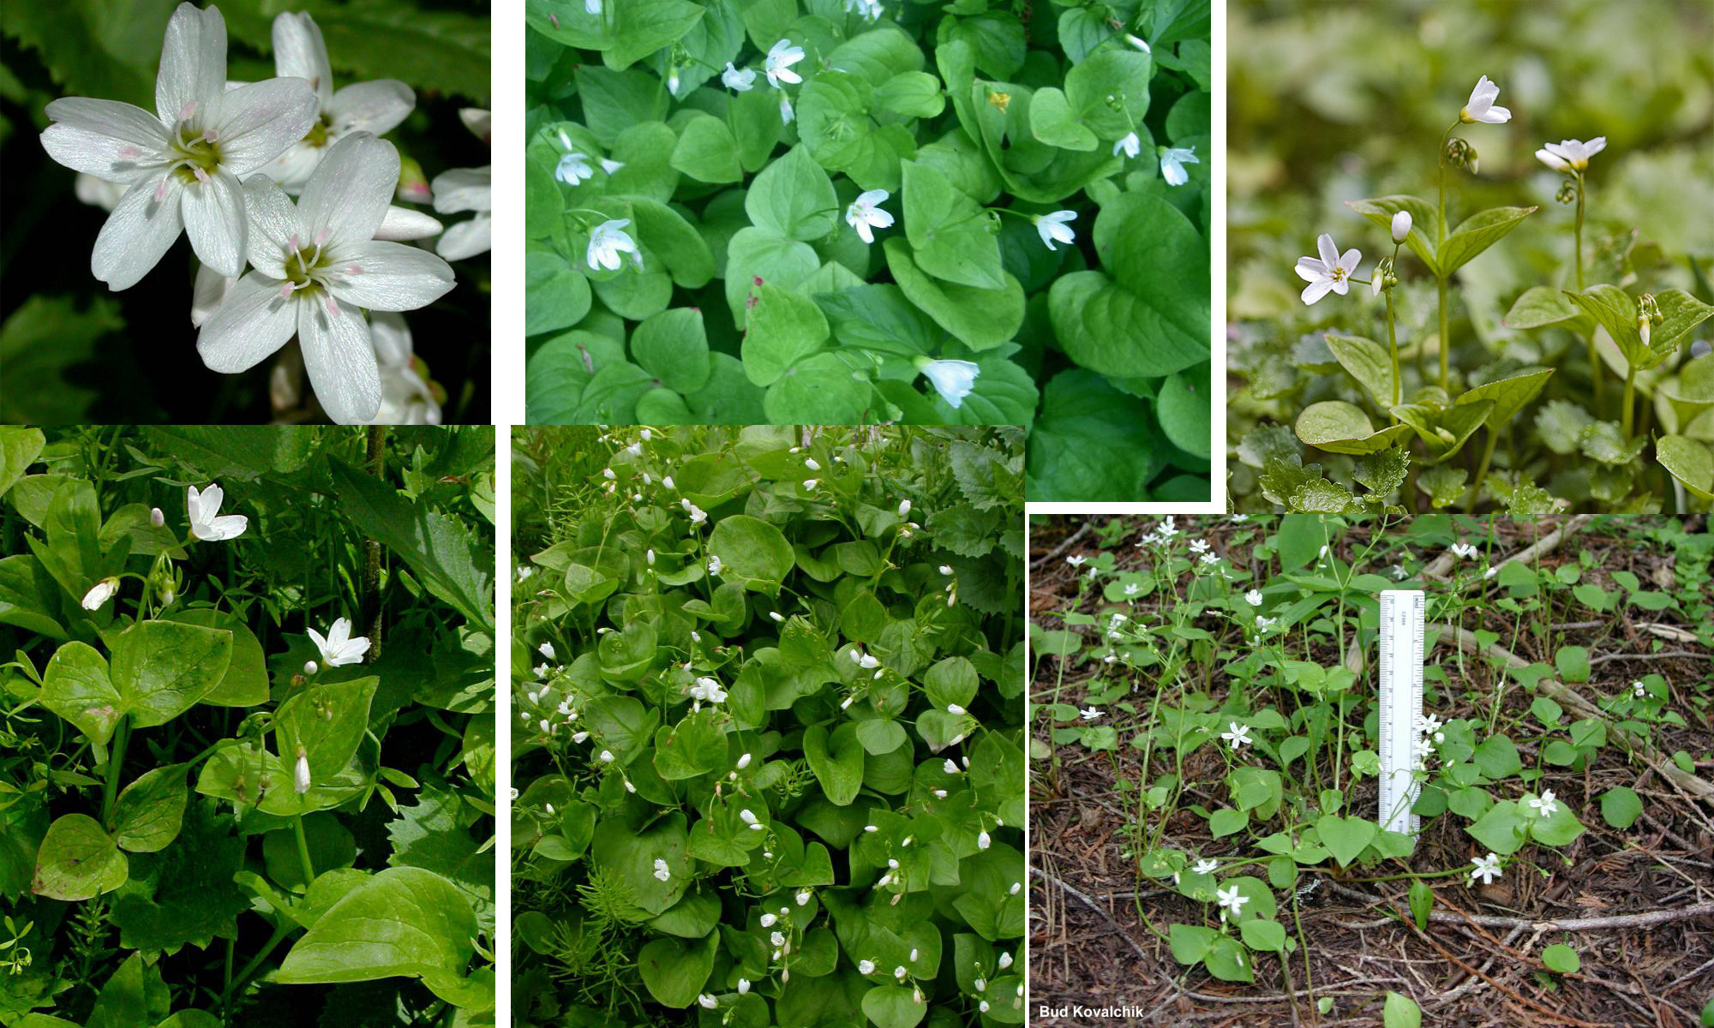
Broad-leafed Montia – Purslane Family

Slide 18
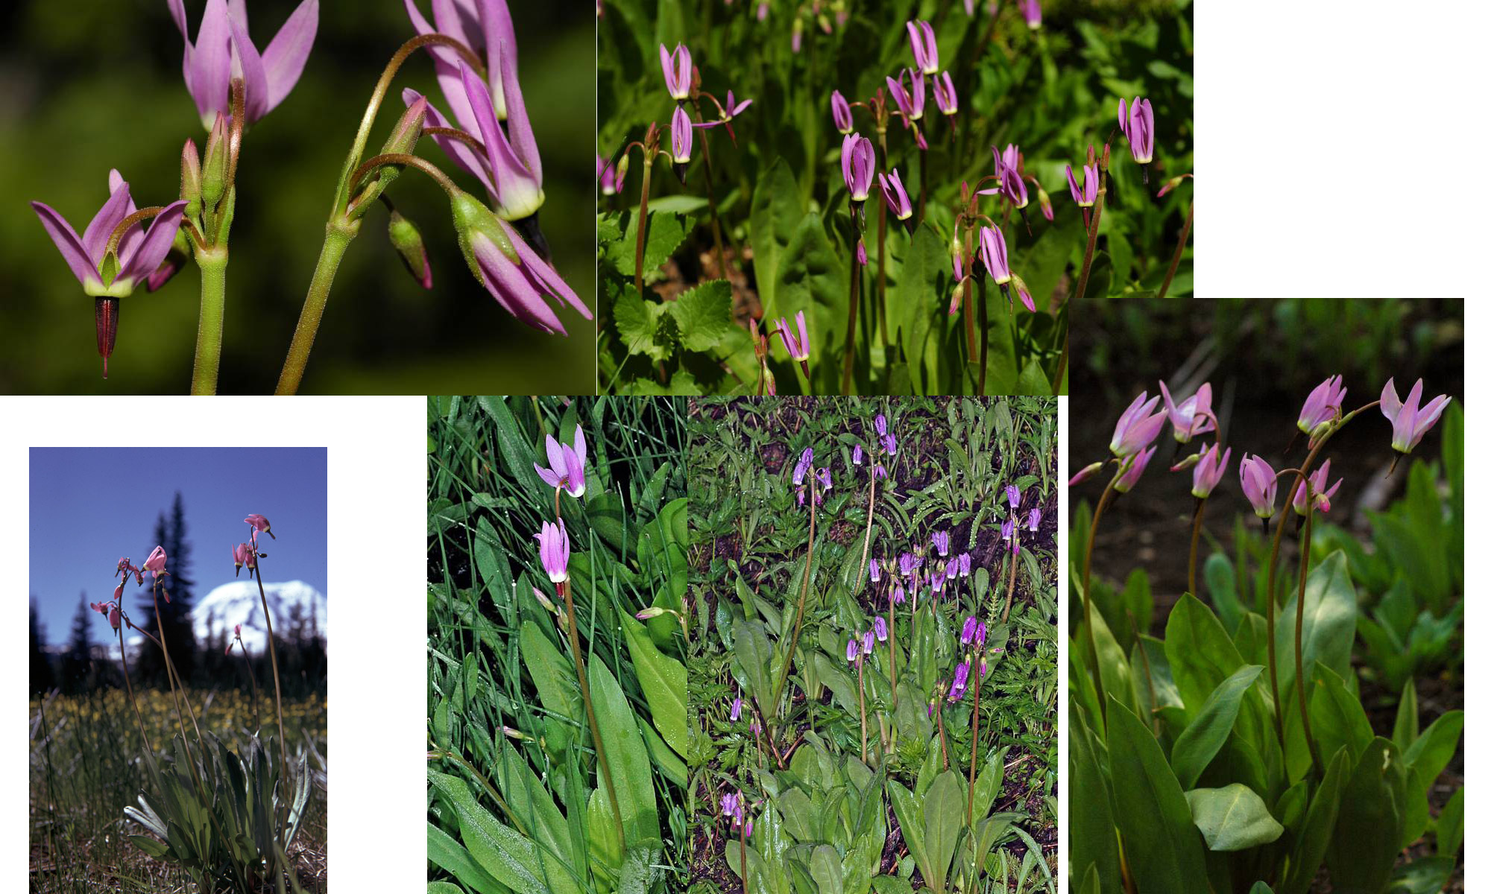
Jeffrey’s Shooting Star – Primrose Family

Slide 19
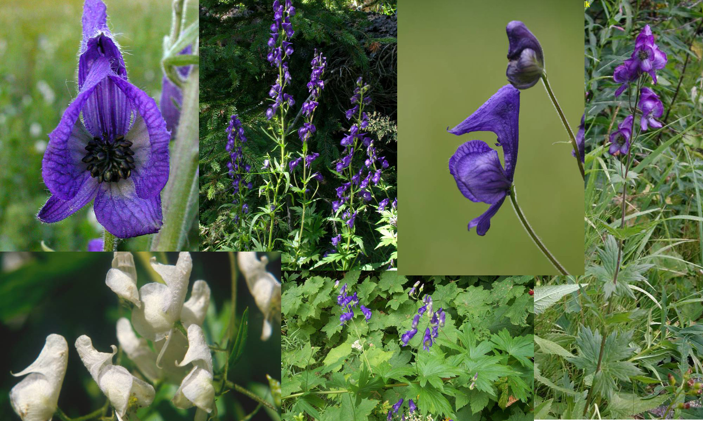
Monkshood –Buttercup Family

Slide 20
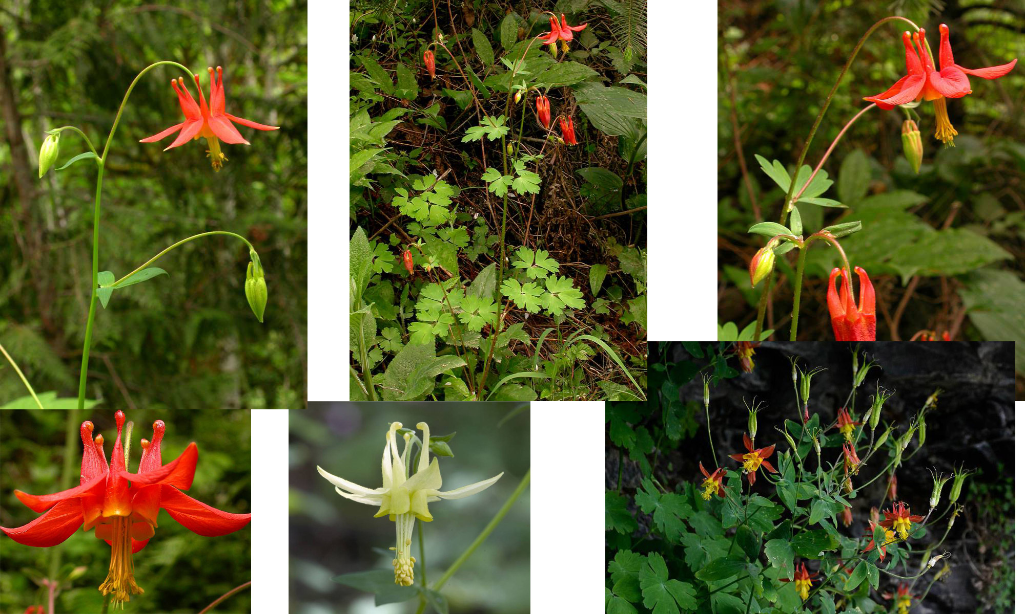
Red Columbine – Buttercup Family

Slide 21
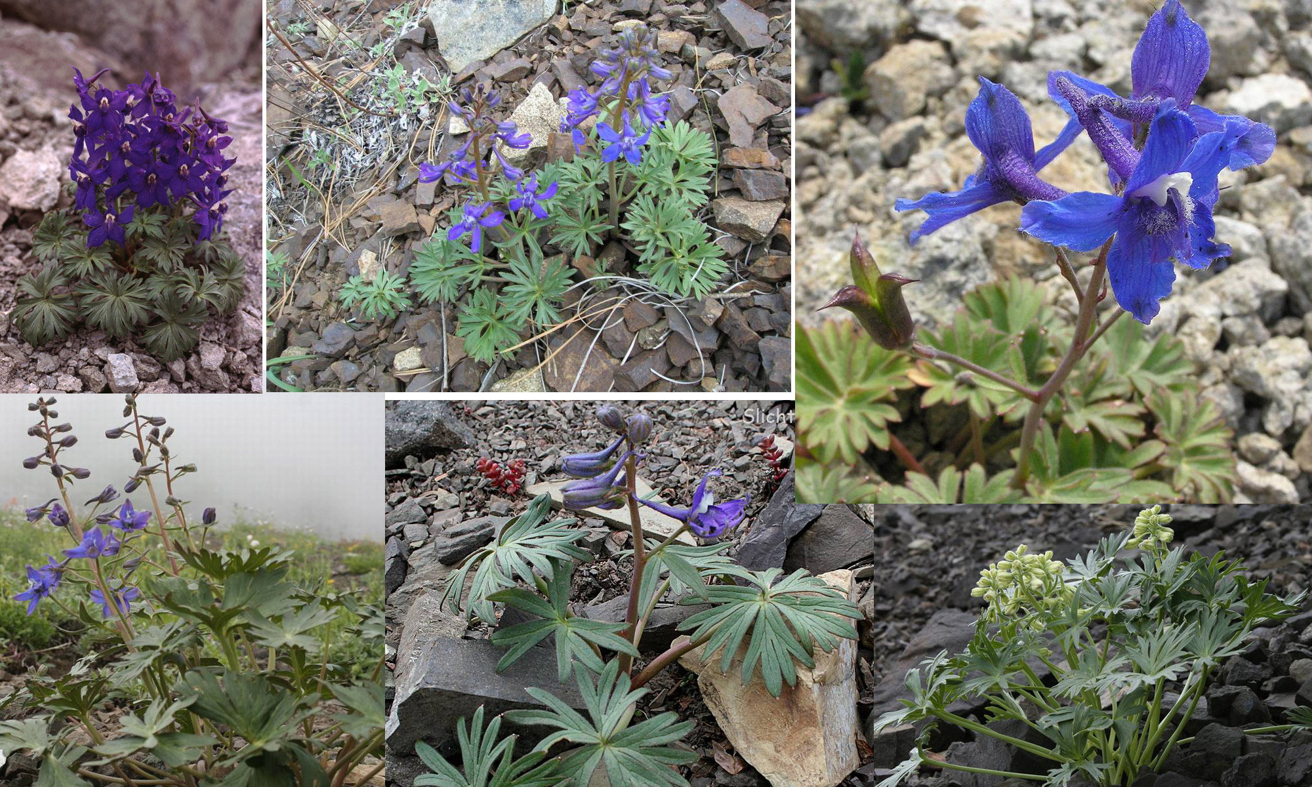
Rockside Larkspur – Buttercup Family

Slide 22
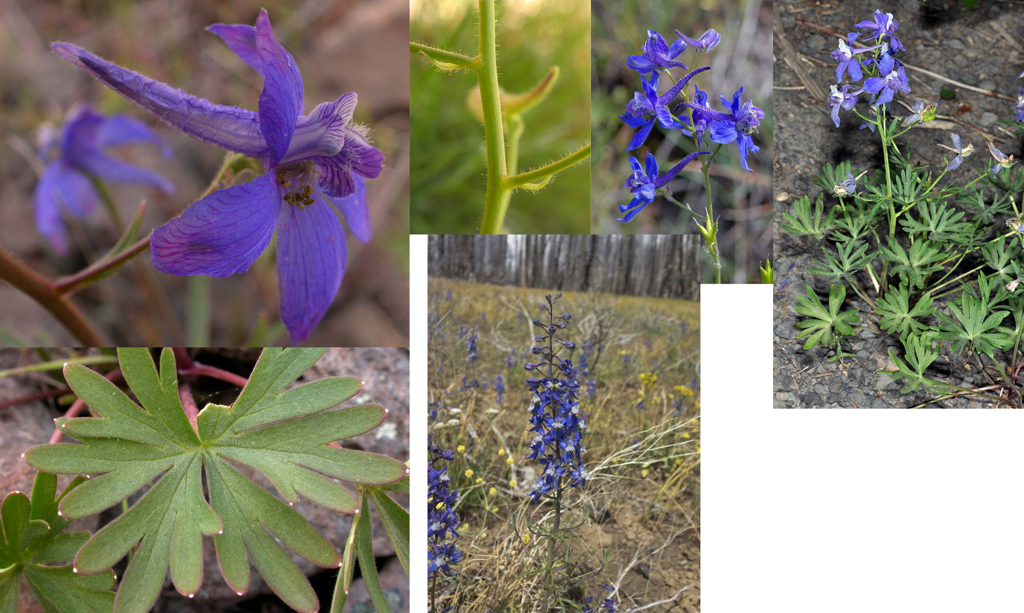
Upland Larkspur – Buttercup Family

Slide 23
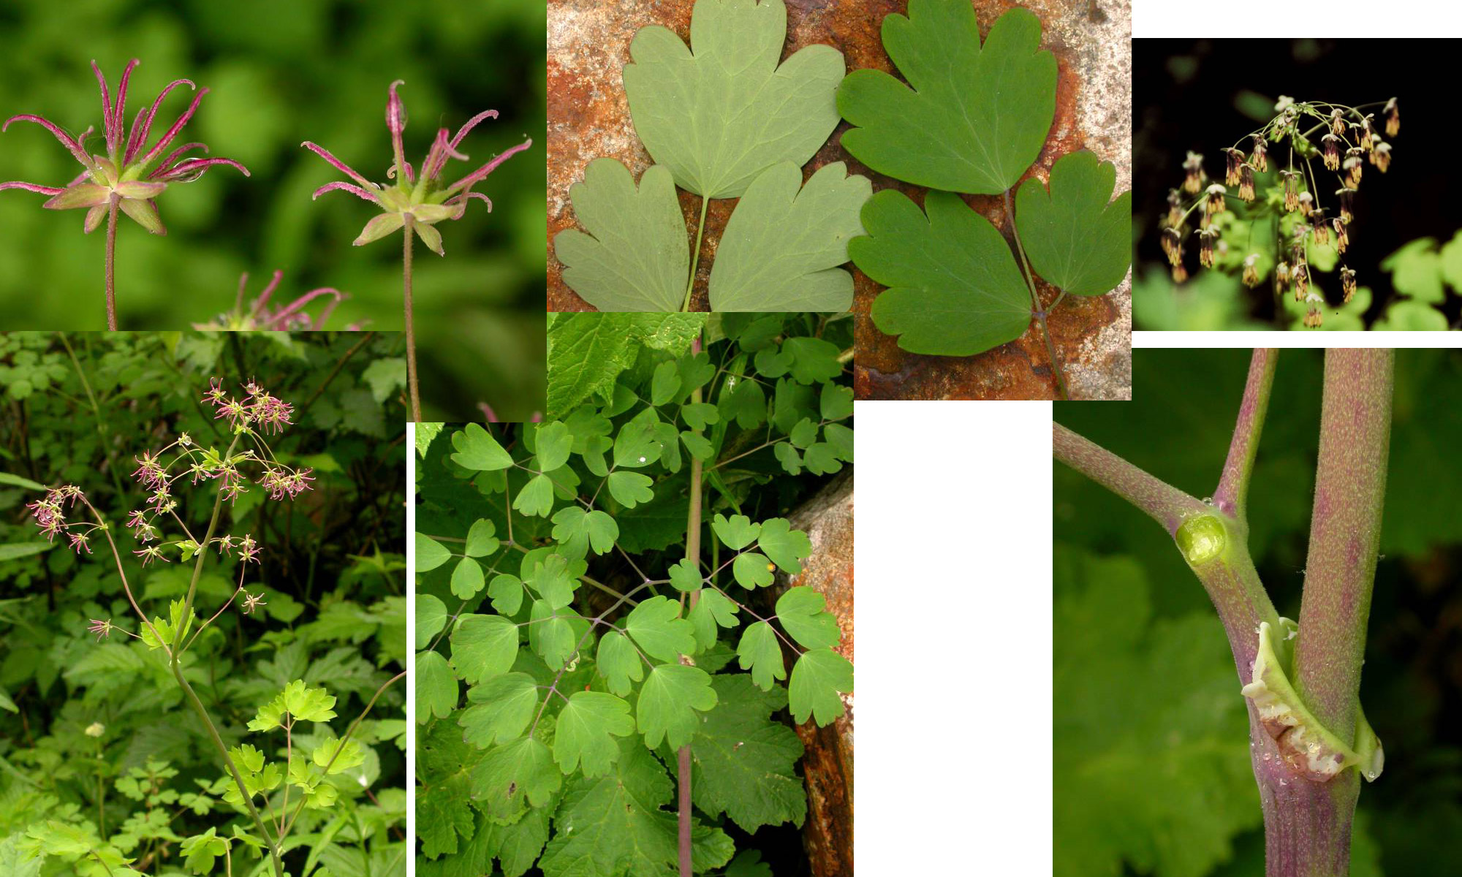
Western Meadowrue – Buttercup Family

Slide 24
Key to Plants (in order of slides)
Sicklepod Rockcress
Thread-leaved Sandwort
Lance-leaved Stonecrop
Pipsissewa
One-sided Wintergreen
Big-leafed Lupine
White-leaf Phacelia
Fireweed
Skyrocket
Spreading Phlox
Northern Buckwheat
Parsnip-flowered Buckwheat
Western Springbeauty
Red-Miner’s Lettuce
Broad-leafed Montia
Jeffrey’s Shooting Star
Monkshood
Red Columbine
Rockside Larkspur
Upland Larkspur
Western Meadowrue

